Slide 1

Graduation project 2022
Supervised By
Prof. Dr. Ahmed Said Eltrass

Slide 2
Breast Cancer Classification
Team members:
Menna Mohamed
Peter Magdy
Ashraf Hussein
Eyad Ahmed
Kirollos Adel
Monica Said
Mina Gebraiel
Fady Gaber

Slide 3

Project workflow

Slide 4
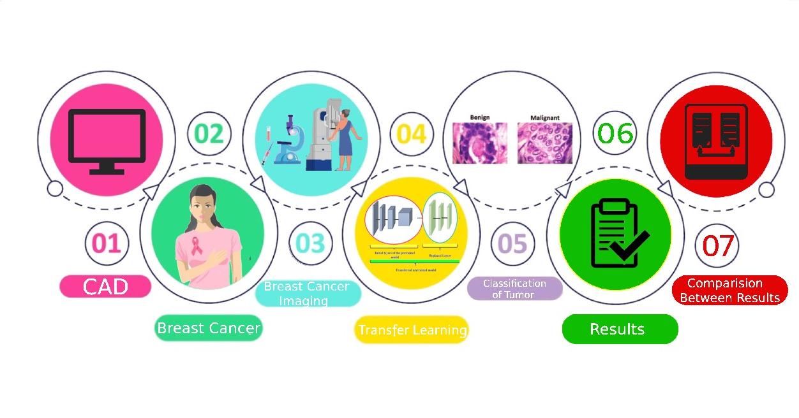
Project Workflow

Slide 5
Project Presentation
Introduction
Menna Mohamed
Peter Magdy
Ashraf Hussein
CAD system
Eyad Ahmed
Kirollos Adel
Experimental results
Monica Said
Mina Gebraiel
Conclusion & Future work
Fady Gaber

Slide 6
Outline
Introduction
Scope of Project
Problem Background
Deep Learning Techniques
Experimental Results
Conclusion and Future Work

Slide 7
Introduction

Slide 8
Introduction
What is cancer ?
Normal vs cancerous cells
Types of tumors
Scope of problem
Why breast cancer ?
Breast anatomy
Types of breast cancer
Breast cancer stages
Breast cancer Imaging

Slide 9
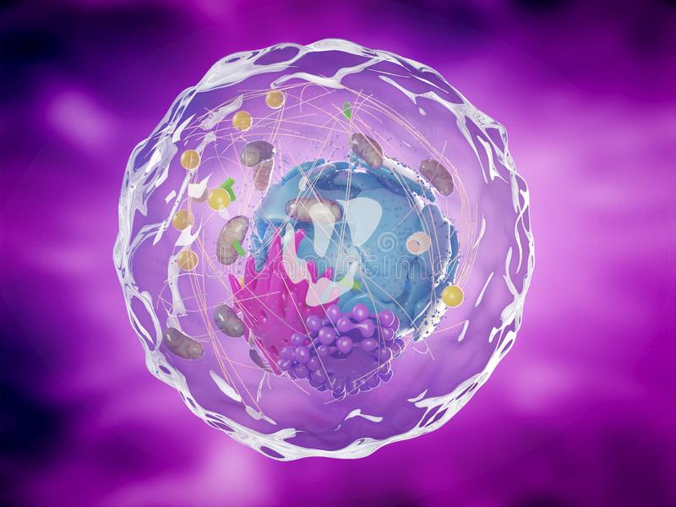
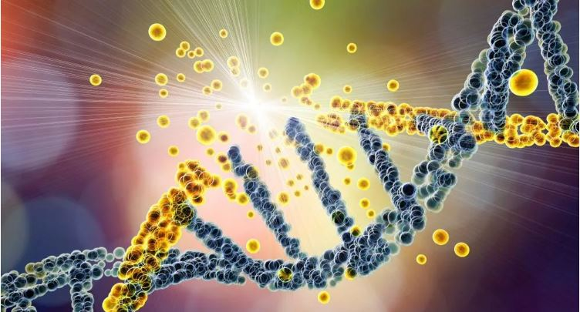
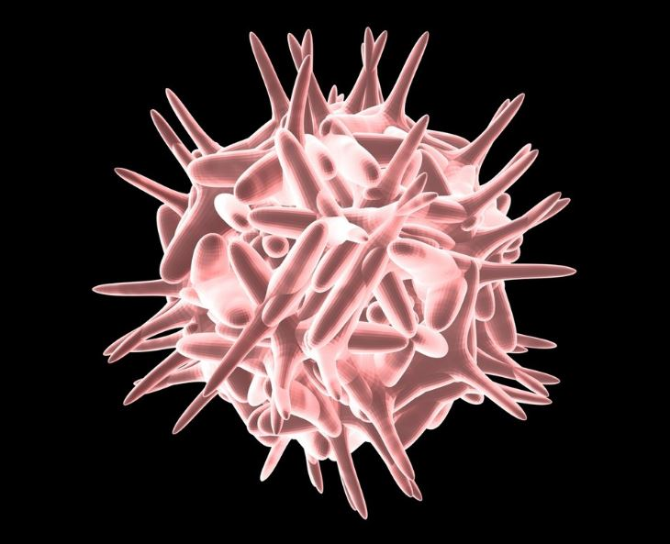
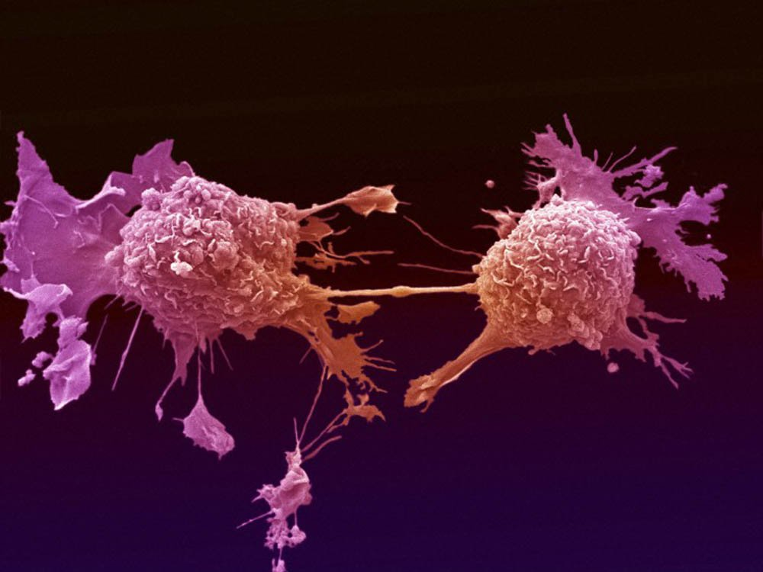
What is Cancer ?
Cancer is a broad term for a class of diseases characterized by abnormal cells that grow and invade healthy cells in the body.
When cell DNA is damaged mutated call begin to rapidly reproduce and old or damaged cells do not die as they should.
When this occurs, a buildup of cells often forms a mass of tissue called tumor.
Step1
Healthy cell
Step2
Damaged DNA in cell
Step 3
Cell becomes mutated
Step 4
Mutated cells grow uncontrollably

Slide 10
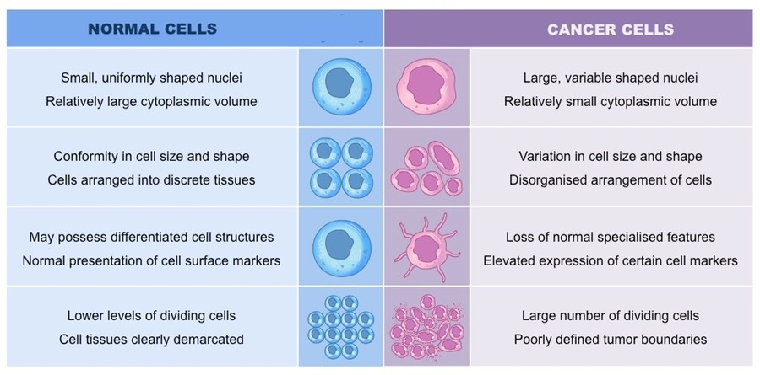
Normal vs. Cancer Cells

Slide 11
Types of Tumors
Features | Benign | Malignant
Growing Rate | Slow | Fast
Invasive | Non-Invasive | Invasive
Shape | Regular (oval-smooth) | Irregular (stellate)
The Pain | Painful | Painless
Adverse Health effects | Relatively smaller | Relatively bigger
A tumor is a mass of abnormal tissue. There are two types of breast cancer tumors: those that are non-cancerous, or ‘benign’, and those that are cancerous, which are ‘malignant’.

Slide 12
Scope of Problem
According to the World Health Organization (WHO), cancer is the second leading cause of death globally, and in 2018, it caused approximately 9.6 million deaths.
There are many types of cancer, such as breast cancer, skin cancer, lung cancer, and prostate cancer.
According to the International Agency for Research on Cancer mentioned that the common diseases for females are breast cancer, and for males are prostate and lung cancer.

Slide 13
Why Breast Cancer ?
Breast cancer is the most common type of cancer in women and considered to be a leading cause of death among the middle aged and old women.
At least one out of eight women is expected to be diagnosed with breast cancer.
In 2020, there were 2.3 million women diagnosed with breast cancer and 685 000 deaths globally.
As of the end of 2020, there were 7.8 million women alive who were diagnosed with breast cancer, making it the world’s most prevalent cancer.

Slide 14
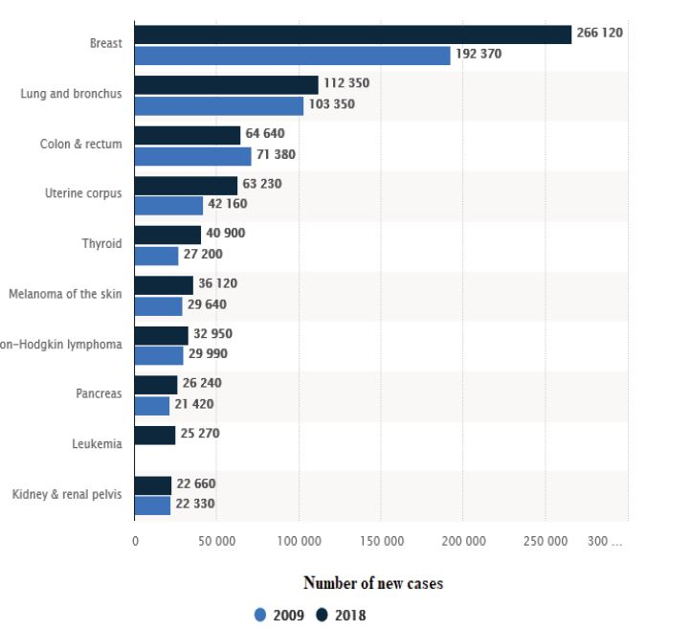
Breast Cancer Statistics
Breast cancer statistics compared with other types of cancer in U.S between 2009 and 2018.

Slide 15
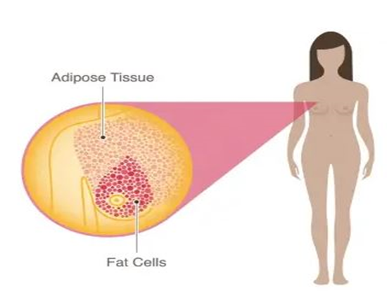
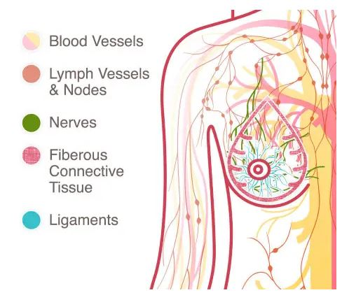
Breast Anatomy
The female breast is mostly made up of a collection of fat cells called adipose tissue, also, a network of lymph system which is part of the immune system that consists of (lymph vessels and lymph nodes).
The lymph vessels transports disease fighting cells and fluids.
The lymph nodes are small, bean-shaped organs acts as filters destroys anything harmful.

Slide 16
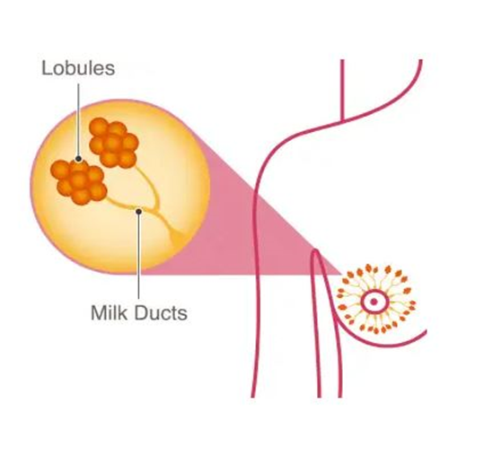
Breast Anatomy
There are also areas called lobes That are made of many small lobules That produces milk.
Both the lobes and lobules are connected by milk ducts which act as tubes to carry the milk to the nipple.

Slide 17
Types of breast cancer
Ductal Carcinoma In Situ (DCIS) : abnormal cells have been found in the lining of the breast milk duct.
Lobular Carcinoma In Situ (LCIS): abnormal cells are found in the lobules of the breast.
Invasive Lobular Cancer (ILC): Invasive breast cancer that begins in the lobules (milk glands) of the breast and spreads to surrounding normal tissue.
Invasive Ductal Carcinoma (IDC) : abnormal cancer cells that began forming in the milk ducts and spread into other parts of the breast tissue. IDC is the most common type of breast cancer.

Slide 18

Breast Cancer Stages
Cancer is assessed by five stages ranging from 0-4.
Each stage represents a progression of the cancer.
As the complexity of the cancer intensifies, so does the treatment required to fight it.

Slide 19
Breast Cancer Stages
Breast cancer staging is classified by:
The size and location of the tumor.
Whether the cancer has spread to nearby lymph nodes or other parts of the body.
The grade of the tumor or how likely it is to grow and spread.
Notes:
Whether certain biomarkers—hormone receptors or other proteins—have been found.

Slide 20
TNM staging system
TNM staging system is used for most types of cancer.
The TNM system uses letters and numbers to describe:
The tumor (T)
Lymph nodes (N)
Whether the cancer has spread or metastasized (M)
The information collected is used to give a specific cancer stage ranging from 0 - 4.

Slide 21
Tumor (T)
The letter T and the number after it describe the tumor by answering these questions:
How large is the primary tumor?
Does it go into other tissues or organs in the same area?
Where is it located?
The letter T is followed by a combination of numbers or letters that gives additional information about the tumor.
I.e., T0 means no evidence of primary tumor, T1-4 describe the size and location of the tumor.

Slide 22
Node (N)
The letter N and the number after it describe if cancer has affected the lymph nodes.
This part of the staging system answers these questions:
Has the tumor spread to the lymph nodes?
If so, which lymph nodes and how many?
After the letter N, there will be a number from 0 (zero) to 3.
N0 means there are no lymph nodes with cancer and the more lymph nodes with cancer, the larger the number.

Slide 23
Metastasis (M)
The letter M and the number after it describes if the cancer has spread. It answers these questions:
Has the cancer spread to other parts of the body?
If so, where and how much?
If cancer has not spread, the stage is M0.
If the cancer has spread to other parts of the body, it is stage M1.

Slide 24
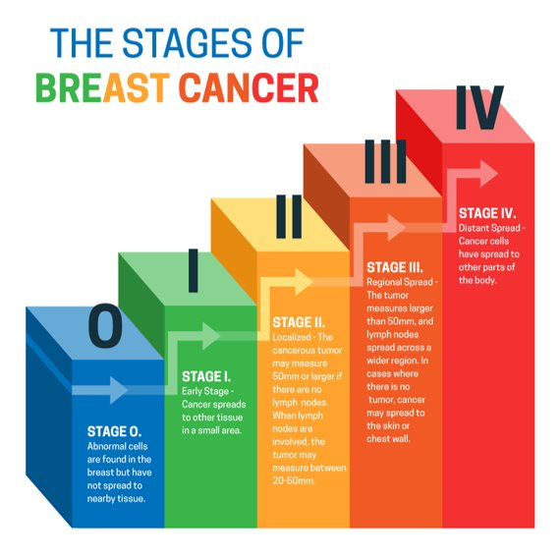
Stages of Breast Cancer

Slide 25
Stage 0 “Carcinoma In Situ”
The earliest stage of breast cancer.
Two possible types of “in situ carcinoma” of the breast tissue are:
DCIS – Ductal carcinoma in situ.
LCIS – Lobular carcinoma in situ.
The most important is ductal carcinoma in situ (DCIS).
Notes:
Lobular carcinoma in situ at Stage 0 generally is not considered cancer.

Slide 26
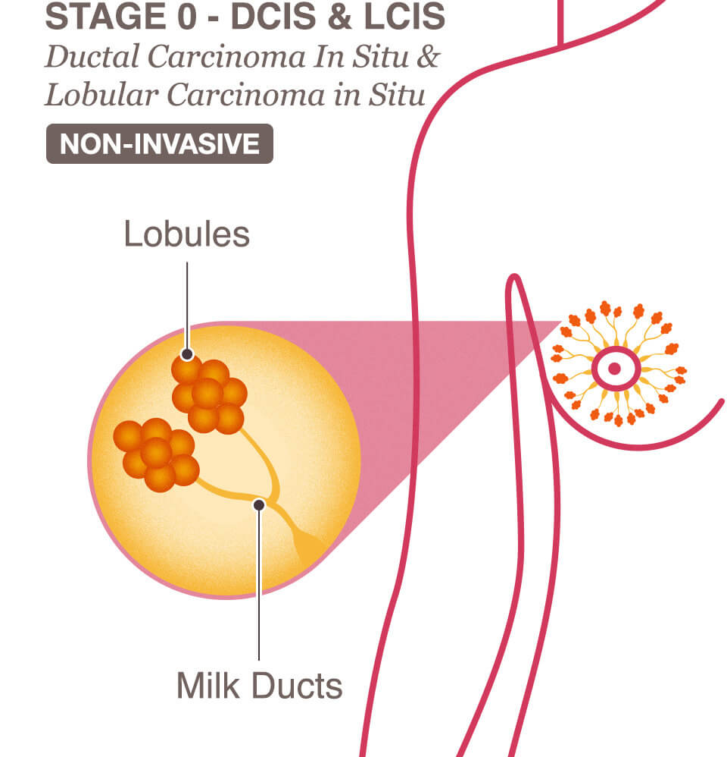
Ductal Carcinoma In Situ (DCIS)
It is a non-invasive cancer where abnormal cells have been found in the lining of the breast milk duct.
The atypical cells have not spread outside of the ducts or lobules into the surrounding breast tissue.
DCIS is very early cancer that is highly treatable, but if it’s left untreated or undetected, it can spread into the surrounding breast tissue.

Slide 27
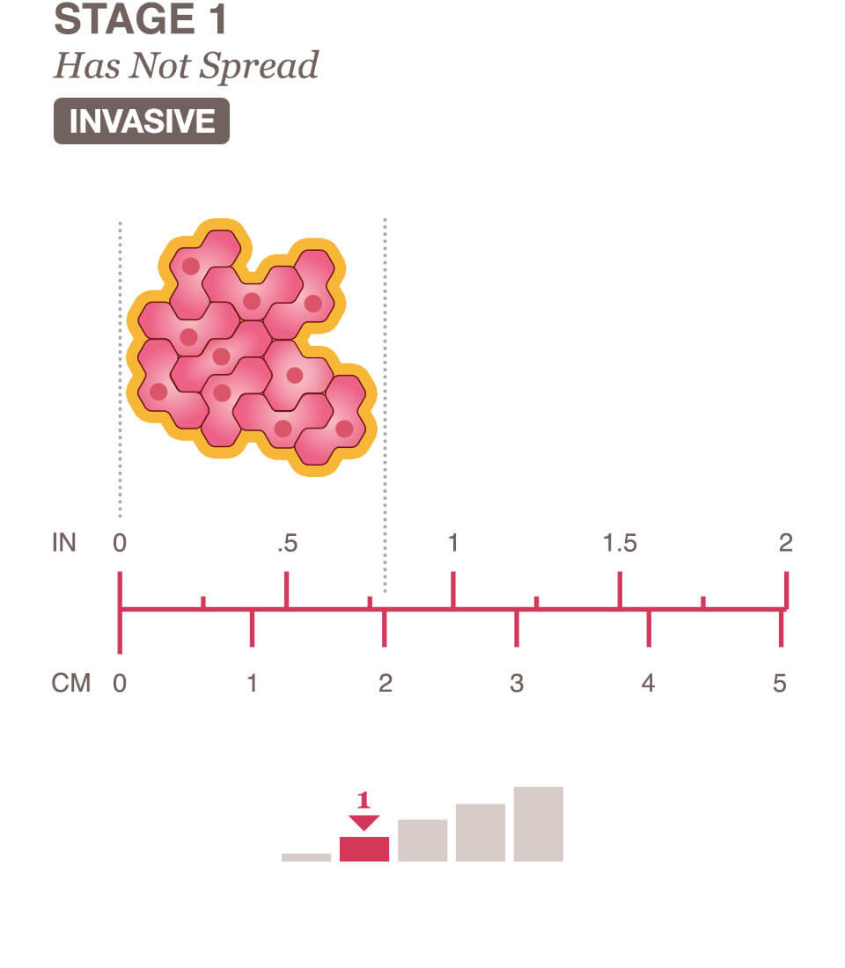
Stage 1 Breast Cancer
In Stage 1 invasive breast cancer, the tumor has not exceeded 2cm.
It can be divided into Stage 1A and Stage 1B:
Stage 1A: The tumor is very small and has not spread to the lymph nodes.
Stage 1B: Cancer between 0.2 mm and 2 mm is found in the lymph nodes.
Notes:
Stage 1 means the tumor is very small and either has not spread or may have a tiny bit of spread in a nearby lymph node.
A cancer that has spread into the surrounding area is referred to as invasive breast cancer.

Slide 28
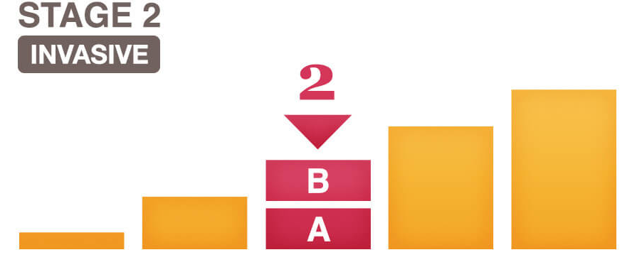
Stage 2 Breast Cancer
Stage 2 means the breast cancer is growing, but it is still contained in the breast or growth has only extended to the nearby lymph nodes.
This stage is divided into groups: Stage 2A and Stage 2B.
The difference is determined by the size of the tumor and whether the breast cancer has spread to the lymph nodes.

Slide 29
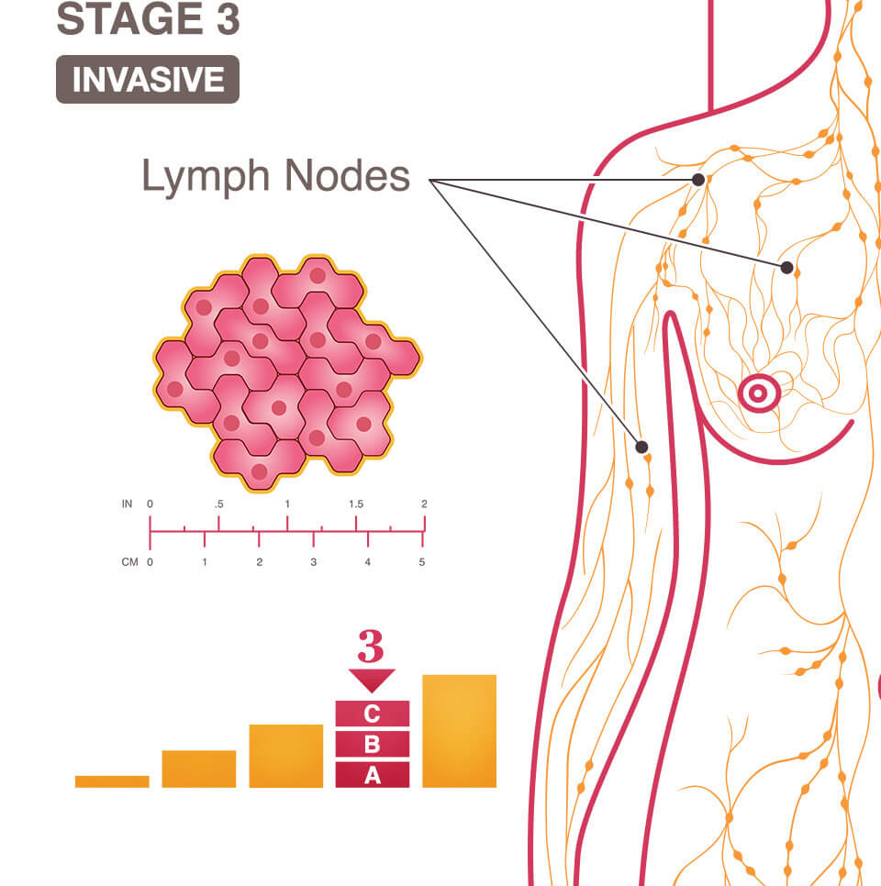
Stage 3 Breast Cancer
Based on the location and number of lymph nodes to which the cancer has spread.
Depends on the size of the tumor and if the chest wall or skin have been affected.
This stage is divided into three groups: Stage 3A, Stage 3B, and Stage 3C.
Notes:
Stage 3 cancer means the breast cancer has extended to beyond the immediate region of the tumor and may have invaded nearby lymph nodes and muscles, but has not spread to distant organs.

Slide 30
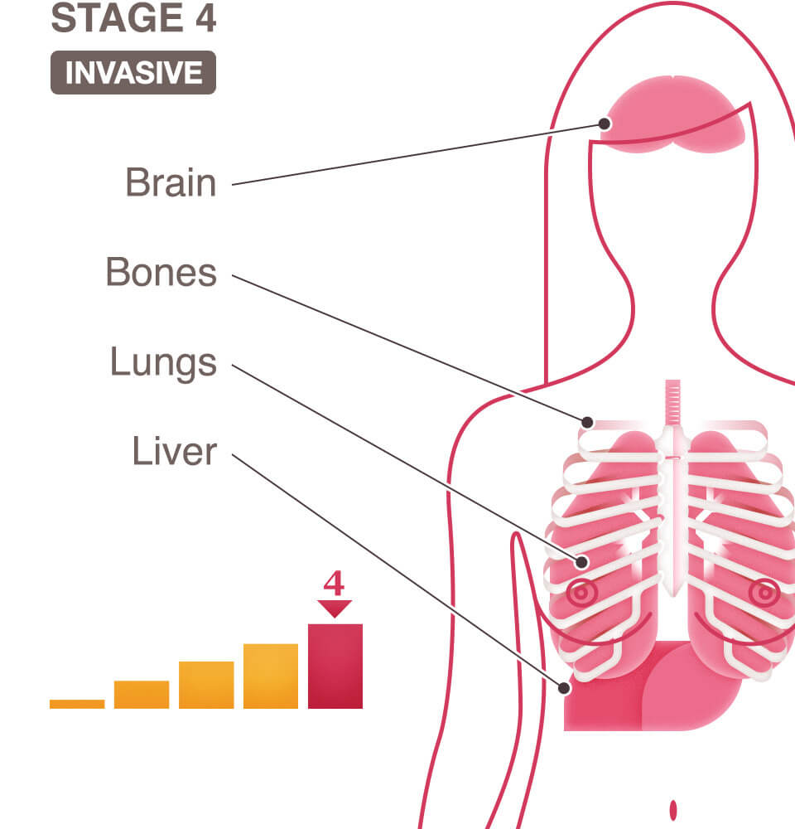
Stage 4 Breast Cancer
Stage 4 is the most advanced stage of breast cancer.
It has spread to other organs of the body; most often the bones, lungs, liver, or brain.
This is known as "metastatic cancer".

Slide 31
Breast Cancer Imaging
Mammogram: An x-ray of the breast.
Ultrasound exam: A procedure in which high-energy sound waves are bounced off internal tissues or organs and make echoes.
MRI: A procedure that uses a magnet, radio waves, and a computer to make a series of detailed pictures of both breasts.
Blood chemistry studies: A procedure where blood sample is checked to measure amounts of certain substances released into the blood by organs.
Biopsy: The removal of cells so they can be viewed under a microscope by a pathologist to check for signs of cancer.

Slide 32
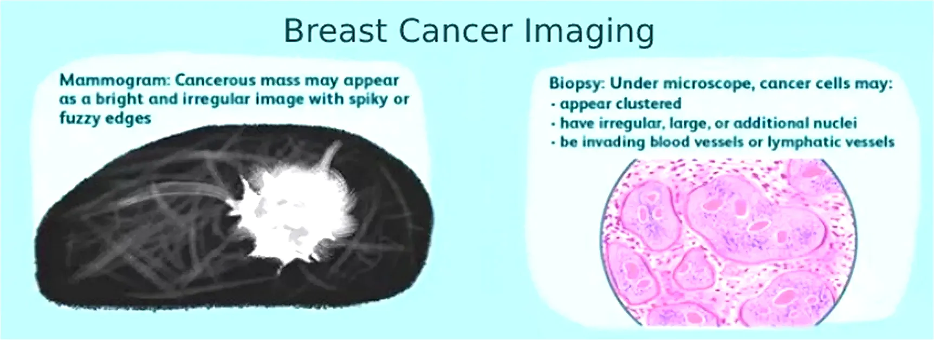
Breast Cancer Imaging
Two types will be discussed : Mammogram and Histopathology.

Slide 33
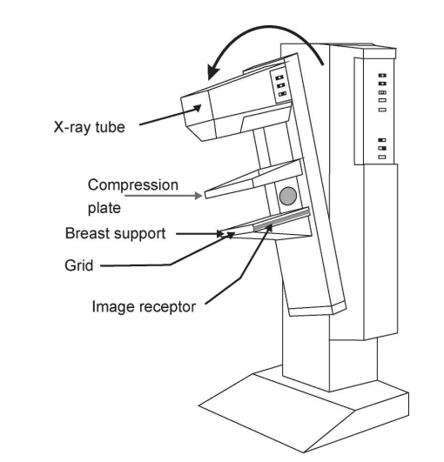
Mammogram device
The grid: is placed between the breast and the image receptor, absorbs scattered radiation improves contrast.
Compression plate: it applies force that displaces the glandular tissues which improves contrast also stabilizing the breast.
Image receptor: it should provide efficient absorption of the incident radiation beam.
X-ray generator and tube: they should provide X ray spectrum with range of energies that give an appropriate compromise between radiation dose and image quality.
Notes:
it applies force that displaces the glandular tissues which improves contrast also reduces movement un-sharpness by stabilizing the breast.

Slide 34
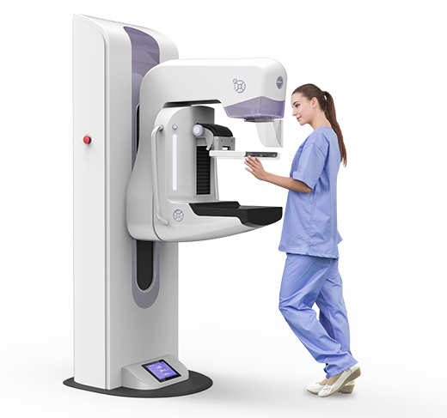
Procedures of Mammogram
breast tissue is pressed by a plat​.
penetrate low energy (20-2 kVp) X-ray​.
radio graphic image is produced.

Slide 35
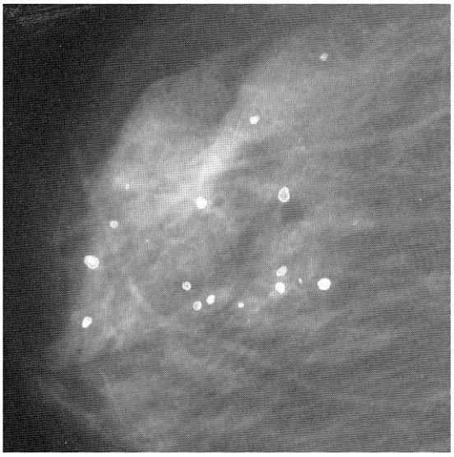
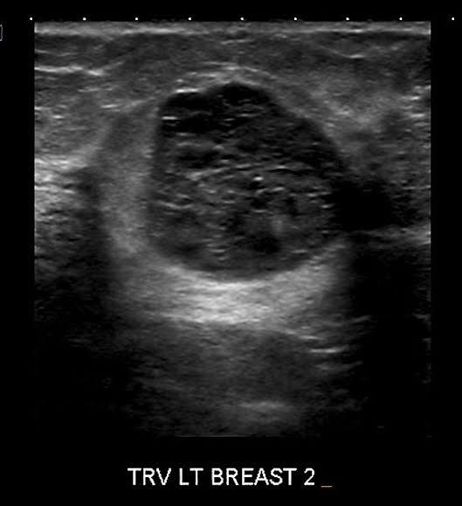
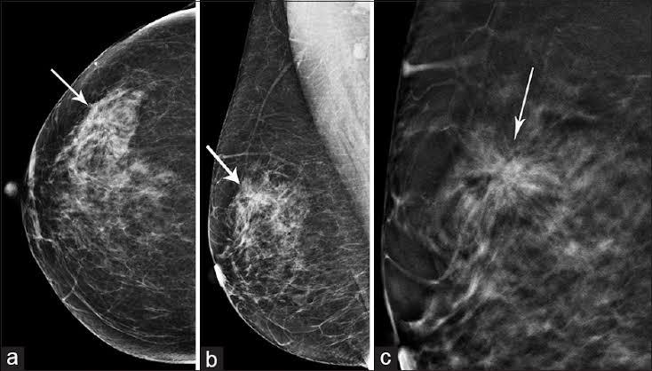
Abnormalities in Mammograms
Mass Lesions: they have high, medium or low density compared to normal fibro-glandular tissue.
Micro Calcification: they are small calcium deposits.
Architectural Distortion: Their appearance increase suspicions that the patient may have breast cancer.

Slide 36
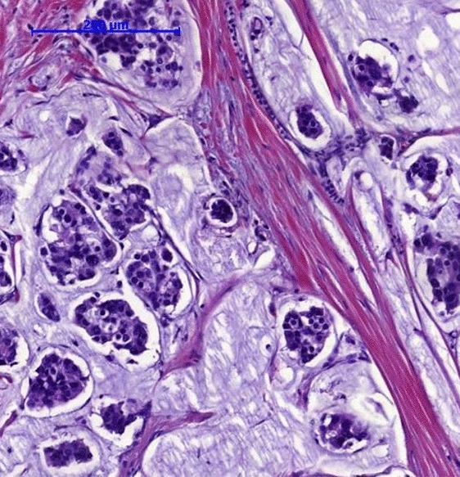
Histopathology Diagnostics
The biopsy is processed and dyed with Hematoxylin and Eosin (H&E) stains.
Pathologist examines the morphological features like shape, size, and color of the Region Of Interest (ROI) such as nuclei.
Studying the structure of the tissue at different magnifications to differentiate them as benign or malignant.
100x the tissue patterns and distributions are studied.
400x cytological features such as shape and size of the nuclei, hyperchromatic nuclei.
Notes:
Hematoxylin stains the nuclei to dark purple or blue and Eosin stains other structures into shades of pink, red, and orange.
Based on these features, pathologists classify the tumor grade the tumor and suitable treatment is given to the affected
Breast cancer can be of different types and each of these types has different microscopic features.
Any change from the expected normal appearance of the nuclei is considered abnormal and further evaluation is carried out to confirm it as a malignant condition.
In some cases, the pathologist also needs to report the tumor grading to know the aggressiveness of cancerous the microscopic patterns of malignant breast tumor.

Slide 37
Scope of project

Slide 38
Scope of project
CAD System
CAD Goals
CAD Methodology

Slide 39
CAD System
Computer-aided diagnosis (CAD): diagnosis by radiologists using the output of a computer analysis of the images when making their interpretation.
Computer-Aided Detection (CADe)
Used with “Screening Radiology”.
Identify and mark suspicious areas in an image.
Computer-Aided Diagnosis (CADx)
Used with “Clinical Radiology”.
CADx help radiologists decide if a woman should have a biopsy or not.

Slide 40
CAD Goals
Improving radiologists’ performance
Reduce intra- and inter-variability of radiologists
improve radiologists’ productivity

Slide 41
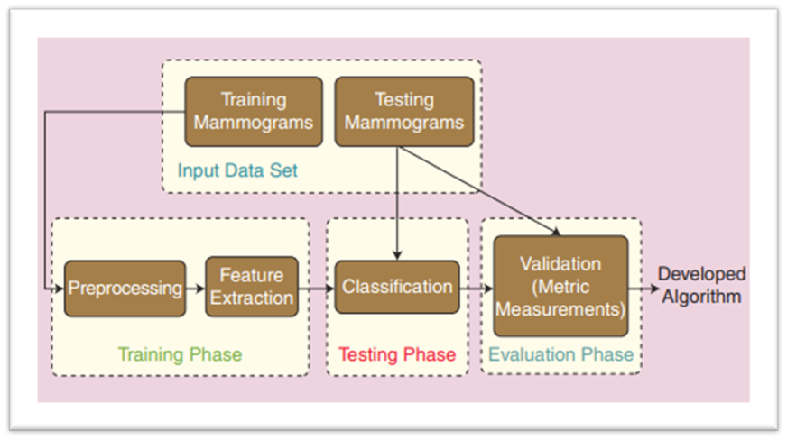
CAD Methodology

Slide 42
Problem Background

Slide 43
Problem Background
Deep Learning
Why Deep Learning ?
Deep Learning Workflow
CNN

Slide 44
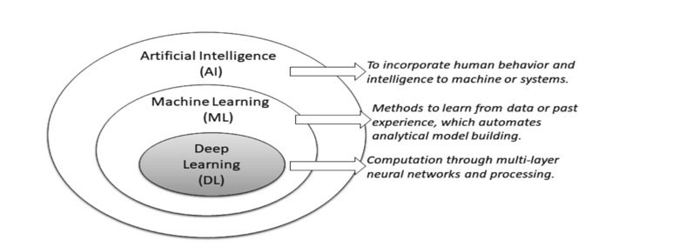
Deep learning
DL is a part of ML as well as a part of the broad area AI and it has grown in recent years due to the advances in computational power and the access to large datasets.

Slide 45
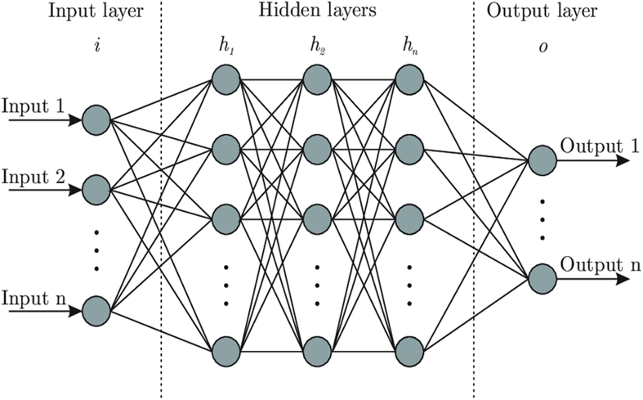
Deep Learning
weights
neurons
layers
Notes:
Deep neural networks consist of an input layer, output layer, and many hidden layers in the middle.
Each layer consists of neurons which are inspired by how neurons in the brain process information.
Each neuron has a weight that is updated using a technique called gradient descent during the training process.
The weights of the network are optimized by minimizing a cost function.
Due to this, neural networks can model complex mappings. After training, the model can classify unseen data.

Slide 46
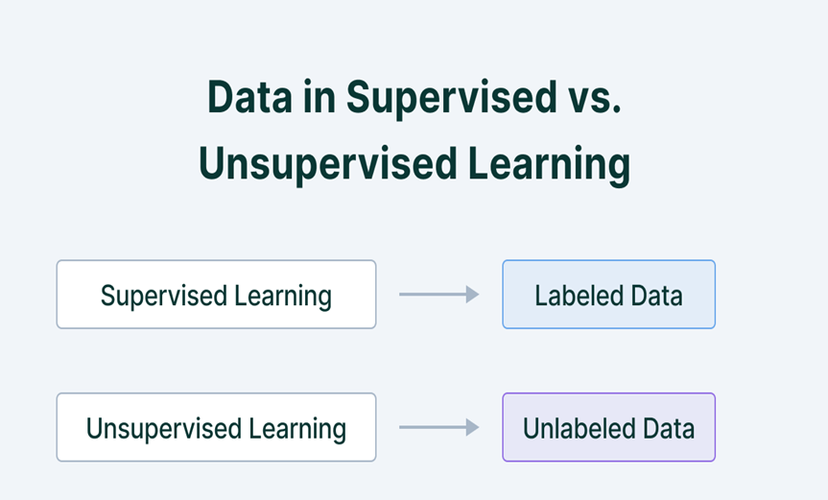
Deep Learning
There are two main categories of deep learning algorithms:
supervised learning.
unsupervised learning.

Slide 47
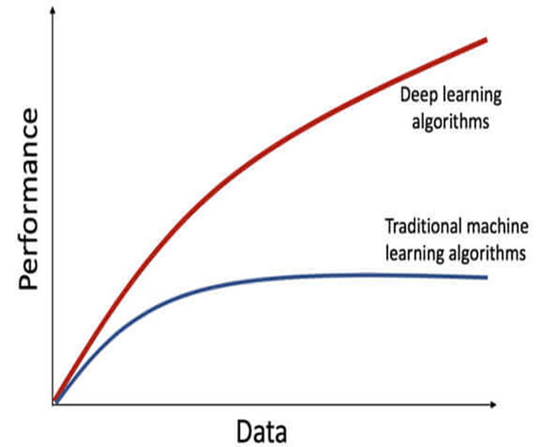
Why Deep Learning?
DL can be a solution to the following problems :
Cases where human experts are not available.
Cases where humans are unable to explain decisions made using their expertise.
Cases where size of the problem is extremely large.

Slide 48
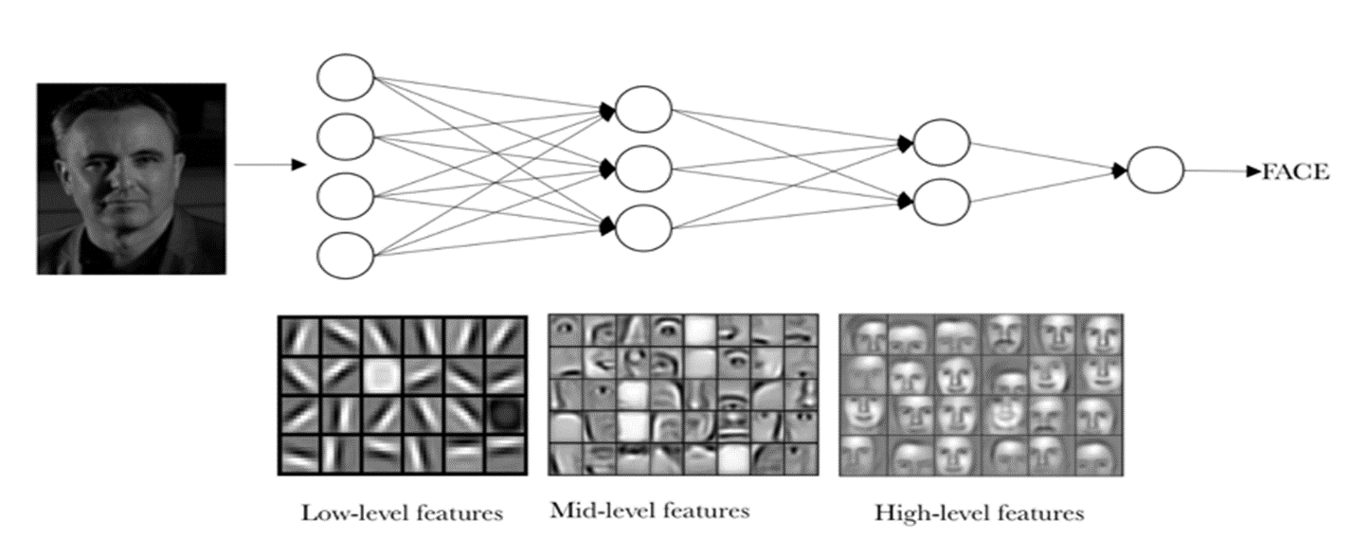
Why Deep Learning?

Slide 49
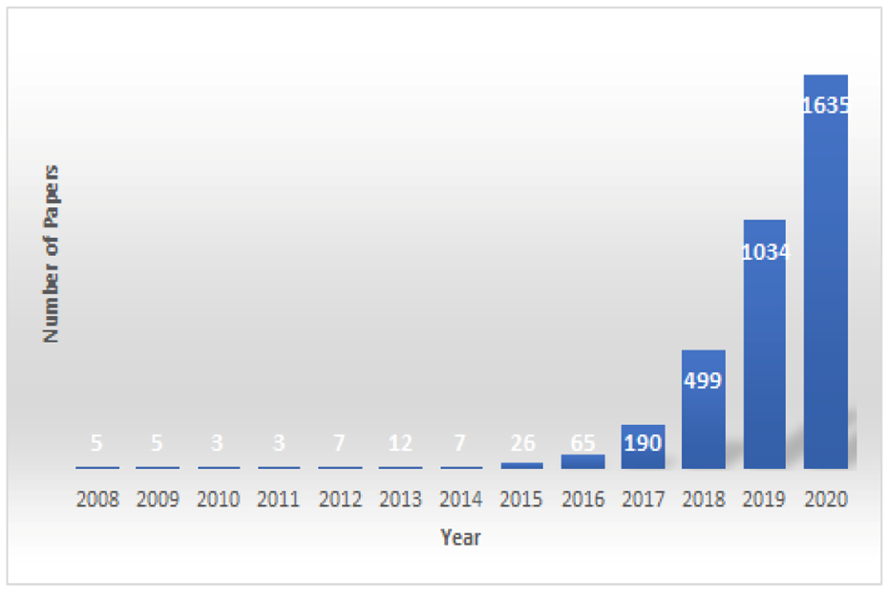
Why Deep Learning?
This figure shows the number of published papers using deep learning models to predict cancer risk, classification, prediction and detection per year since 2008[4].

Slide 50
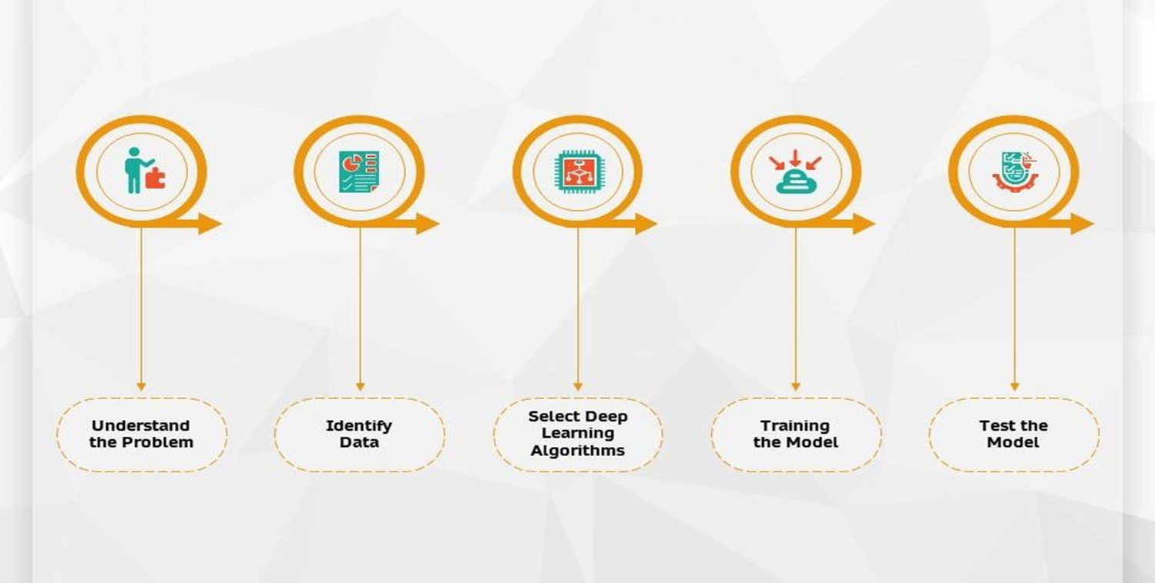
Deep Learning Workflow

Slide 51
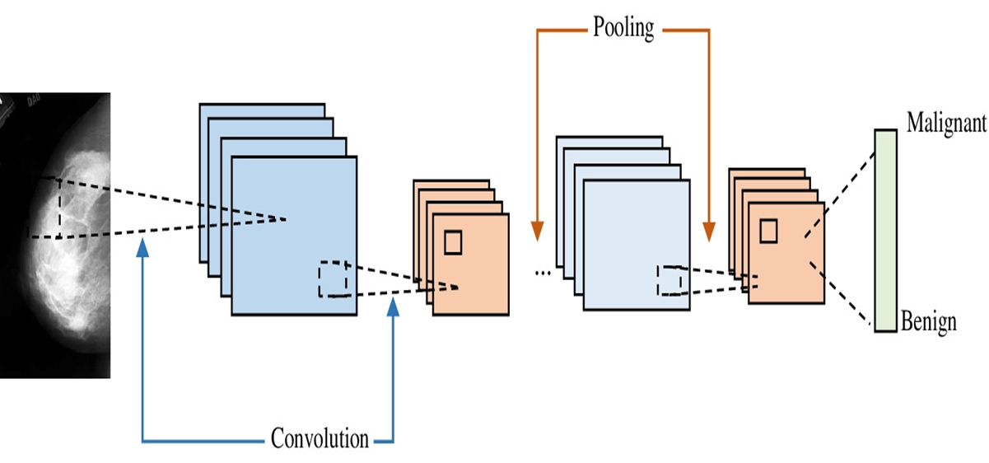
CNN
It has been proved to work very well in vision tasks. Some of the recently proposed CAD systems adopted the renowned deep learning techniques and obtained promising results.
• Convolutional layer.
• Pooling layer.
• Fully connected layer.

Slide 52
Deep Learning Techniques

Slide 53
Deep Learning Techniques
Transfer Learning
Use Cases
Approaches
Pretrained Models

Slide 54
When Does Transfer
Learning Make
Sense ?
Both tasks have the same input format.
More data for Task A than Task B (newer problem with relatively less data).
Low level features from Task A could be helpful for learning in Task B.
Notes:
e.g. In radiology it's difficult to get many high-quality scans to build a good diagnosis system from scratch.

Slide 55
Transfer Learning Approach
x
ŷ
ŷ
Notes:
1st phase of training: train all the usual params in neural net and its weights using data set (x1,y1)
Implement transfer learning”:

Slide 56
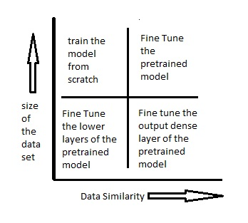
Fine-tuning Vs. Pretraining

Slide 57
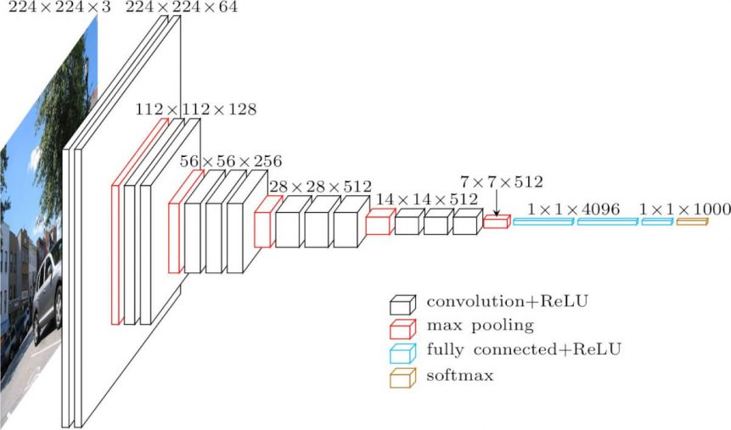
VGG16
535MB size.
138 Mil params.
13x Convolution Layers.
5x Pooling Layers.
3x Dense Layers.
Input: Image (224x224x3)
Hidden Layers: ReLU
Output: Softmax (1000 ch.)
Notes:
Dev by Simonyan and Zisserman 2014

Slide 58
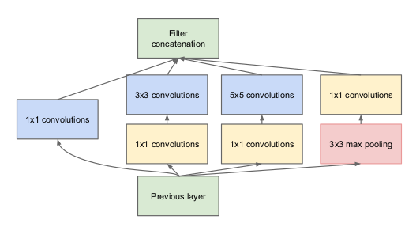
InceptionV3
89MB size
23.9 Mil params
48 Layer Depth
Improvements:
Introduction of Batch Normalization
More factorization
Auxiliary Classifiers
Notes:
2014 by google called googlenet

Slide 59
Experimental results

Slide 60
Experimental Results
Mammogram
Histopathology
Conclusion & Future work

Slide 61
Mammogram

Slide 62
Mammogram Datasets
MIAS (Mammographic Image Analysis Society).
(DDSM) The Digital Database for Screening Mammography.
CBIS-DDSM (Curated Breast Imaging ).
INbreast database.
King Abdulaziz University Mammogram Dataset.

Slide 63
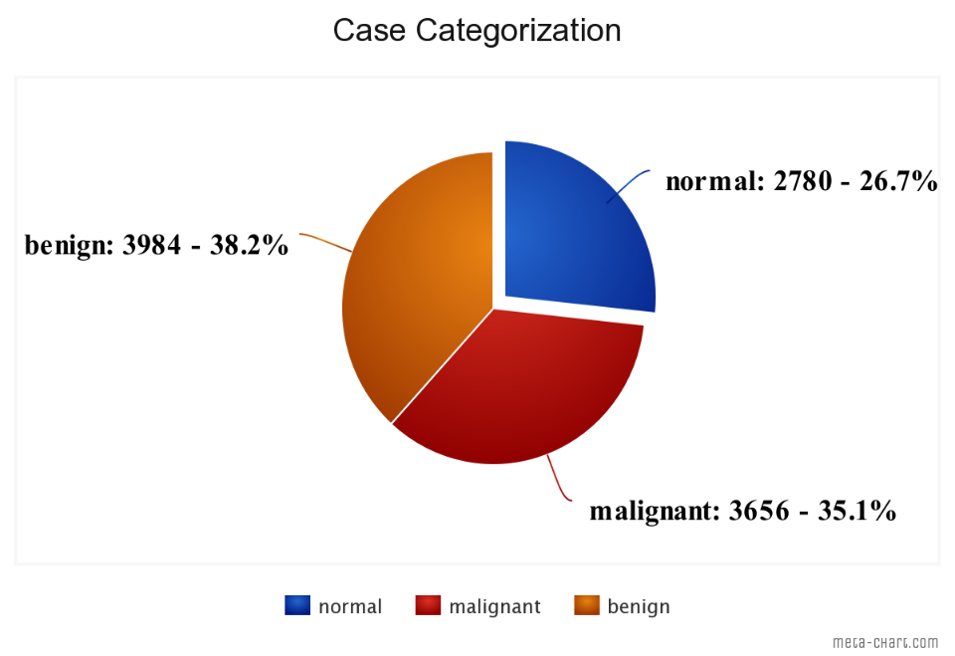
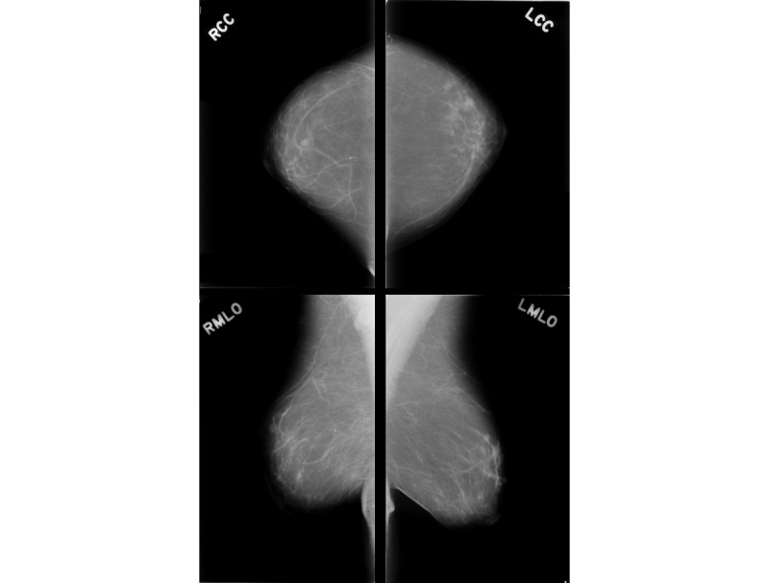
DDSM Dataset
DDSM (Digital Database of Screening Mammography)
The DDSM is a data base of 2,620 scanned film mammography studies.
Contains normal, benign, and malignant cases with verified pathology information.
For each case, four images would be found which are MLO and CC views for each breast.
Consists of 10420 images in jpg format divided into 3984 benign, 3656 cancer and 2780 normal.

Slide 64
DDSM Dataset Selection
The number of images used was 1000 image of total images, with a percentage of 50% benign and 50% malignant.
the data then was divided into a percentage of 60% train, 20% test and 20% validation.
the dimensions of images were changed into 224x224, the images were categorized into two class [0, 1] for malignant and [1, 0] for benign.

Slide 65
Pretrained Models Used
Densenet201
VGG16
VGG19
Resnet50
Inception V3

Slide 66
Hyper-Parameters
Optimizer: Adam.
learning rate: 1e-5.
Epochs: 100.
Batch size: 32.
Early stopping.
ReduceLROnPlateau.
Notes:
20 epochs if validation accuracy did not show signs of improvement.
Reduce learning rate when a metric has stopped improving. for a 'patience' number If epochs the lr is reduced

Slide 67
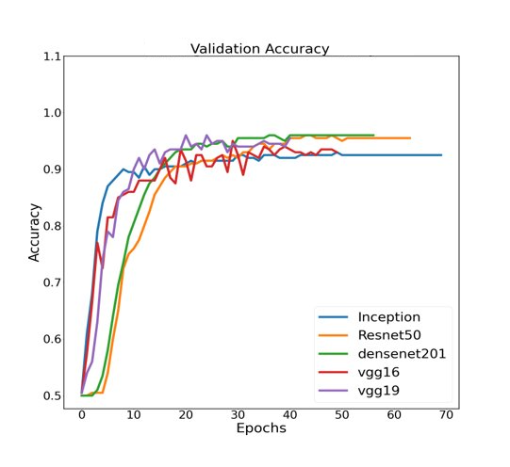
Accuracy Curves

Slide 68
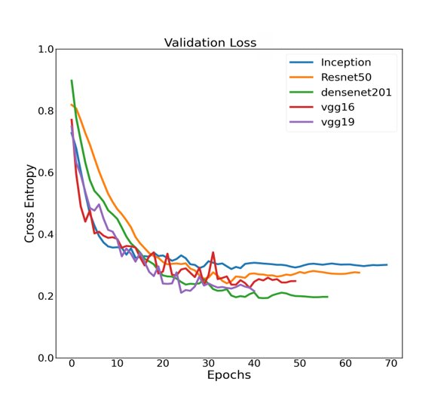
Loss Curves

Slide 69
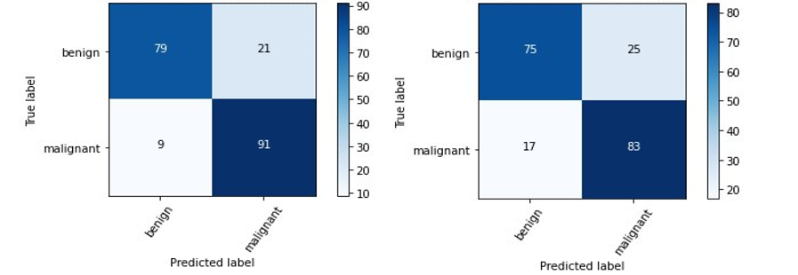
Confusion Matrices
DenseNet201 confusion matrix
InceptionV3 confusion matrix

Slide 70
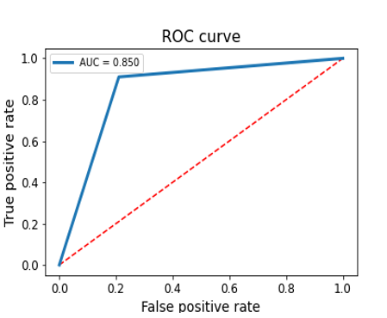
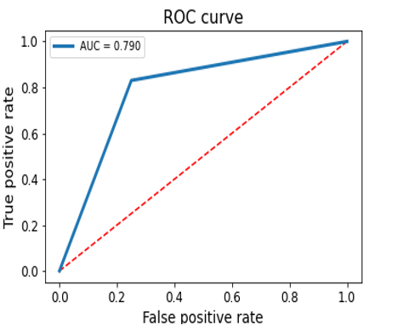
ROC Curves
DenseNet201 ROC curve
InceptionV3 ROC curve

Slide 71
Classification Report
Model | Precision | Recall | F1 Score | Specificity | Accuracy
DensNet201 | 81% | 91% | 86% | 79% | 85%
VGG19 | 79% | 93% | 86% | 76% | 84%
VGG16 | 80% | 86% | 83% | 78% | 82%
ResNet50 | 78% | 92% | 84% | 74% | 83%
Inception V3 | 77% | 83% | 80% | 75% | 79%

Slide 72

K-fold Cross Validation
Divide the data to k equal parts (folds).
1-fold testing + (k-1) folds training.
The process for all the folds and the accuracy is averaged.
5-fold are the most used.
Even better, repeated cross-validation.

Slide 73
5-fold Classification Report
Model | Precision | Recall | Specificity | Accuracy
DensNet201 | 83±1.215% | 94.2±3.42% | 80.8±1.83% | 88.3±1.36%
VGG19 | 84±2.63% | 93±5.01% | 82±4.14% | 85.5±2.54%
VGG16 | 80.7 2.72% | 94.8±5.01% | 77.2±4.06% | 85±1.43%
ResNet50 | 77.7±2.9% | 89±4.09% | 74±5.70% | 80.2±1.02%
Inception V3 | 79.5±1.70% | 90.3±3.87% | 76.5±3.13% | 84.7±0.60%

Slide 74
Results
Model | VGG16 | ResNet50 | VGG19 | InceptionV3 | DenseNet 201
Size | 528 MB | 99 MB | 549 MB | 92 MB | 80 MB
Accuracy | 82% | 83% | 84% | 79% | 85%
Time per Image (CPU) | 0.650 | 0.258 | 0.857 | 0.339 | 0.480
parameters | 14,847,554 | 23,801,218 | 20,289,090 | 22,034,978 | 18,342,914

Slide 75
Histopathology

Slide 76
Histopathology Datasets
Breast Cancer Histopathology (BACH).
the Cancer Metastases in Lymph Nodes, Invasive Ductal Carcinoma (IDC).
Breast Cancer Histopathological Image Classification (BreakHis).
Stanford Tissue Microarray (TMA).
Bio-Image Semantic Query User Environment (BISQUE).

Slide 77
BreakHis Dataset
The Breast Cancer Histopathological Image Classification (BreakHis).
Contains 2,480 benign and 5,429 malignant.
Magnification | Benign | Malignant | Total
40x | 625 | 1370 | 1995
100x | 644 | 1437 | 2081
200x | 623 | 1390 | 2013
400x | 588 | 1232 | 1820
Total | 2480 | 5429 | 7909
Patients | 24 | 58 | 82
Notes:
Composed of microscopic images of breast tumor tissue collected from 82 patients using different magnifying factors.

Slide 78
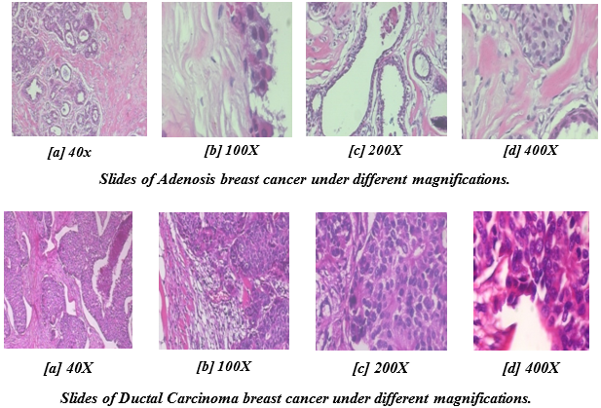
BreakHis Dataset Selection
An equal number of images is used 4,960 in total (2480 benign and 2480 malignant).
The data is divided into 3 different sets train, test, and validation with percentages 60%, 20%, 20% respectively.
The dimensions of images were changed into 224x224 and 299x299 pixels depending on the used model.
The images were categorized into two class benign and malignant.

Slide 79
Pretrained Models Used
DenseNet 201
MobileNet
Xception
EfficientNet B3
VGG 19

Slide 80
Hyper-Parameters
Optimizer: Adam.
learning rate: 1e-5.
Epochs: 100.
Batch size: 32.
Early stopping.
ReduceLROnPlateau.

Slide 81
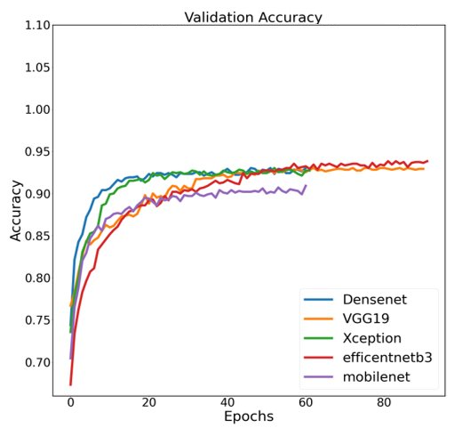
Accuracy Curves

Slide 82
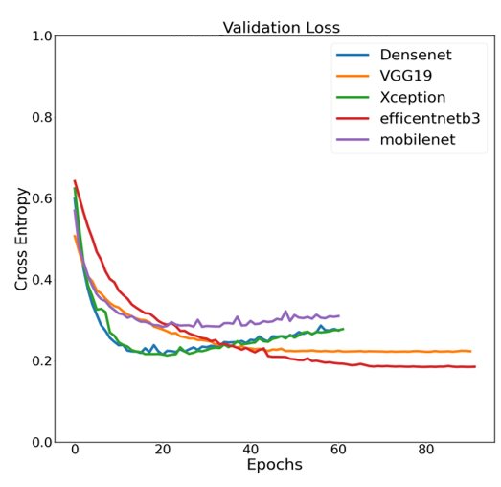
Loss Curves

Slide 83
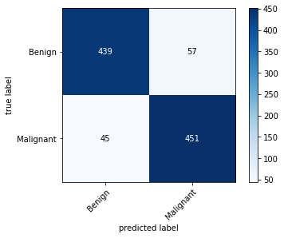
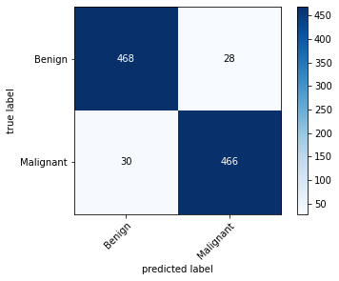
Confusion Matrices
MobileNet Confusion Matrix
VGG19 Confusion Matrix

Slide 84
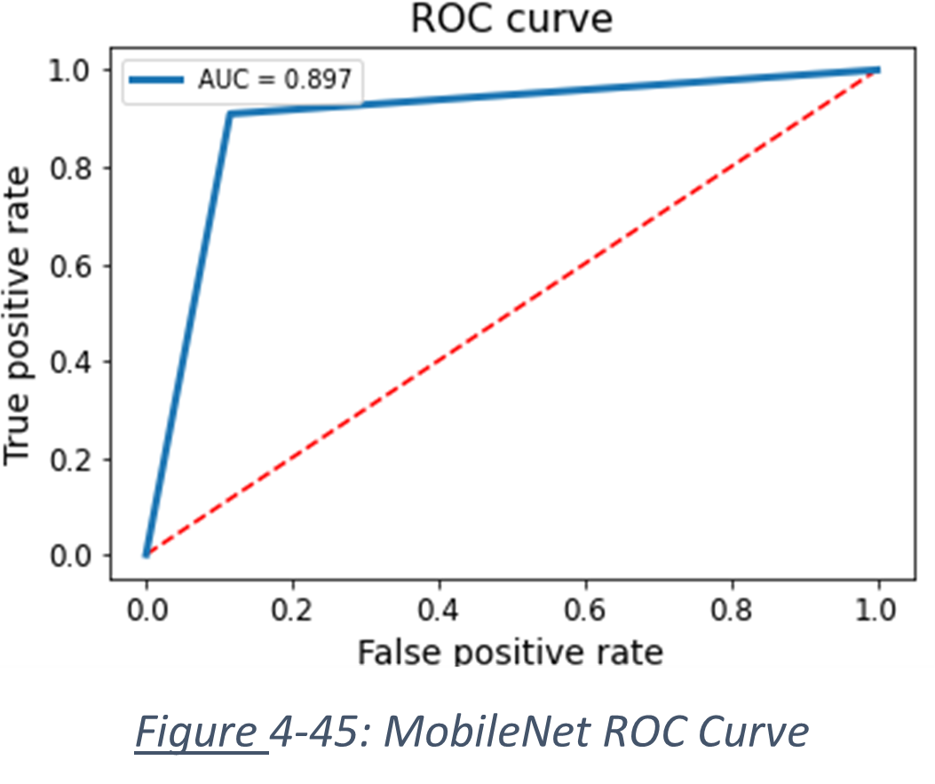
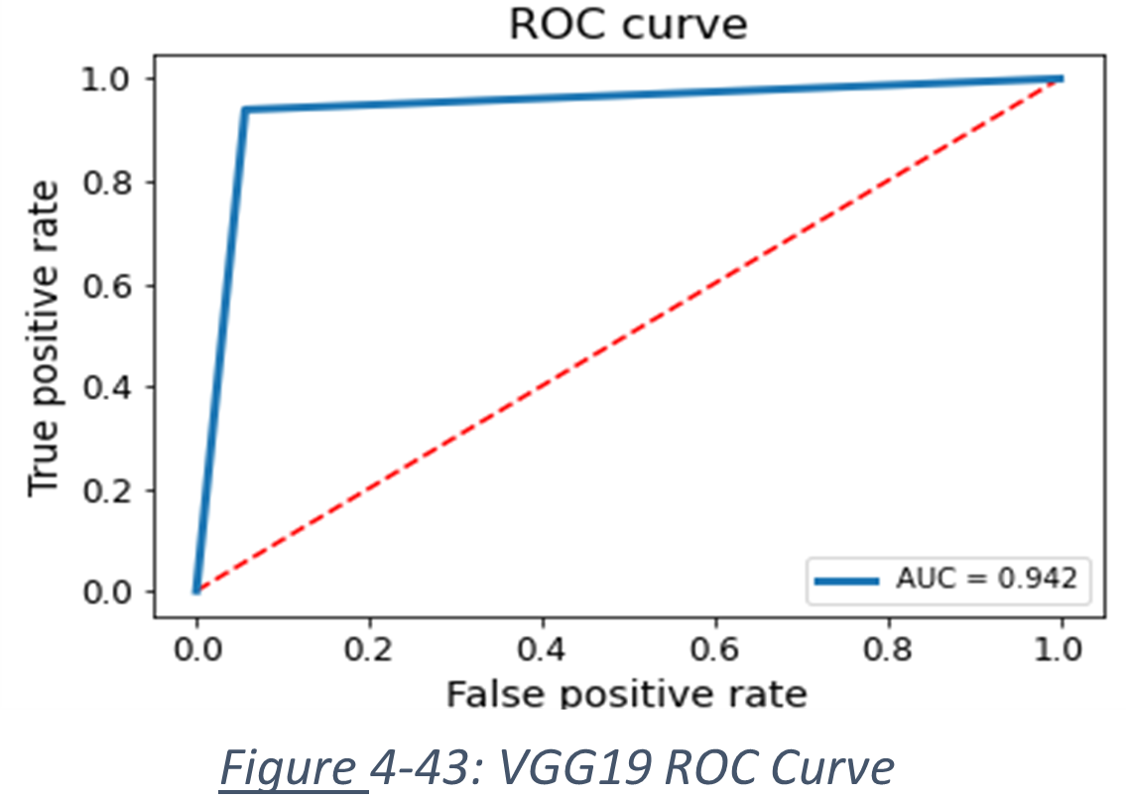
ROC Curves
MobileNet ROC curve
VGG19 ROC curve

Slide 85
Classification Report
Model | Precision | Recall | F1 score | Specificity | Accuracy
DenseNet 201 | 91.9% | 92.7% | 92.3% | 92% | 92.3%
MobileNet | 90.9% | 88.8% | 89.6% | 90.7% | 89.7%
Xception | 91.7% | 92.9% | 92.4% | 91.8% | 92.3%
EfficientNet B3 | 93% | 91% | 92% | 93% | 92%
VGG 19 | 94.5% | 92.9% | 93.7% | 94.6% | 93.7%

Slide 86
5-fold cross Validation
Model | Precision | Recall | Specificity | Accuracy
DenseNet 201 | 95.04±0.71% | 88.88±0.53% | 94.67±0.72% | 91.57±0.37%
MobileNet | 93.46±1.87% | 86.78±0.79% | 92.96±0.29% | 89.61±0.72%
Xception | 90.72±0.54% | 85.61±0.51% | 90.14±0.5% | 87.74±0.3%
EfficientNet B3 | 89.17±1.12% | 88.3±0.79% | 89.56±0.95% | 88.91±0.54%
VGG19 | 89.87±1.53% | 86.95±1.38% | 89.54±1.37% | 88.18±0.99%

Slide 87
Results
Model | VGG19 | MobileNet​ | EfficientNet B3 | Xception | Densenet 201​
Size​ | 549 MB​ | 16 MB​ | 48 MB​ | 88 MB​ | 80 MB​
Accuracy​ | 93.75% | 89.7%​ | 92% | 92.3% | 92.3%
Time/ img (GPU)​ | 16.09​ | 21.66​ | 18.58​ | 33.5​ | 51.98​

Slide 88
Conclusion and Future Work

Slide 89
Conclusion
Histopathology:
Best model to use, with the highest overall performance is VGG 19 (accuracy=93.8%, sensitivity=92.9%, specificity =94.6%)
Worst model to use is MobileNet (accuracy =89.7%, sensitivity=88.8%, specificity=90.7%)
Time per image(ms) :Densenet201 (51.98), VGG19 (34.136), EfficientNet(18.58), Xception (33.5) and MobileNet (21.66).

Slide 90
Conclusion
Mammography imaging
Best model to use , with the highest overall performance is DenseNet201 (accuracy =85%, sensitivity=91%, specificity=79%).
Factors in model selection: low computational cost: Densenet201 (1.0), VGG19 (1.1), VGG16 (0.9), Resnet50 (0.7) and InceptionV3 (0.5).

Slide 91
Conclusion
The classification of breast cancer using the tools we have used will assist the radiologists to prioritize and automate mammograms diagnosis .
It will help patients to get early treatment, which may result in a reduced mortality rate in breast cancer cases.

Slide 92
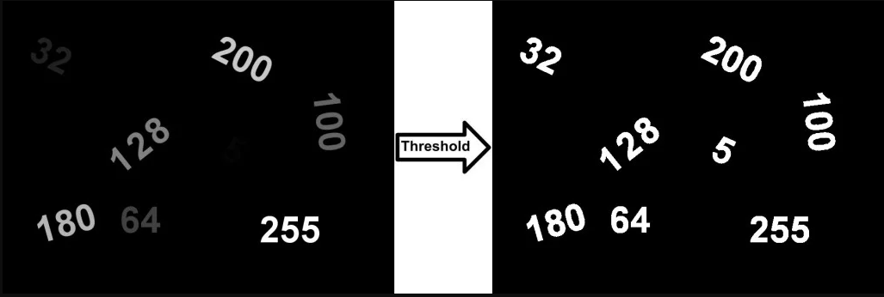
Future Work
The interest in improving CAD systems in mammography is clear since the disease is a public health problem with high rates of both incidence and mortality.
TL performance evaluation in other datasets such as INbreast and Mias.
Improve mammogram preprocessing using global contrast normalization (GCN), local contrast normalization, and Otsu’s threshold segmentation.
Notes:
Improve mammogram preprocessing as it is often an area where significant performance gains can be found by using techniques such as global contrast normalization (GCN), local contrast normalization, and Otsu’s threshold segmentation.
Artefacts such as tags on the x-rays and black backgrounds should all be removed using computer vision techniques to avoid having the CNN learn irrelevant features.

Slide 93

Future Work
Removal of artifacts (tags on x-rays, black backgrounds) using Computer Vision.
Segmentation and feature extraction using ML techniques to help in the comparison between original ground truth of the mammogram and the model prediction.
It helps with the localization of the tumor and automates the usual process of contouring the tumor which is manually done by radiologists.

Slide 94

Future Work
Take advantage of the continuous updates in pretrained models to train our histopathology and mammogram datasets on other pretrained models to get the best accuracy and low computational cost.

Slide 95

Thank You

Slide 96
References
[1] Sarker, I.H., 2021. Deep learning: a comprehensive overview on techniques, taxonomy, applications and research directions. SN Computer Science, 2(6), pp.1-20.
[2] Alom, M.Z., Taha, T.M., Yakopcic, C., Westberg, S., Sidike, P., Nasrin, M.S., Hasan, M., Van Essen, B.C., Awwal, A.A. and Asari, V.K., 2019. A state-of-the-art survey on deep learning theory and architectures. Electronics, 8(3), p.292.
[3] Sha, Z., Hu, L. and Rouyendegh, B.D., 2020. Deep learning and optimization algorithms for automatic breast cancer detection. International Journal of Imaging Systems and Technology, 30(2), pp.495-506.

Slide 97
References
[4] Gulum, M.A., Trombley, C.M. and Kantardzic, M., 2021. A review of explainable deep learning cancer detection models in medical imaging. Applied Sciences, 11(10), p.4573.
[5] Tang, J., Rangayyan, R.M., Xu, J., El Naqa, I. and Yang, Y., 2009. Computer-aided detection and diagnosis of breast cancer with mammography: recent advances. IEEE transactions on information technology in biomedicine, 13(2), pp.236-251.
[6] Rashmi, R., Prasad, K. and Udupa, C.B.K., 2022. Breast histopathological image analysis using image processing techniques for diagnostic puposes: A methodological review. Journal of Medical Systems, 46(1), pp.1-24.

Slide 98
References
[7] [National Breast Cancer Foundation
[8] Rethinking the Inception Architecture for Computer Vision" by Szegedy, et. Al.
[9] What is cancer? National Cancer Institute. (n.d.). Retrieved March 20, 2022, from https://www.cancer.gov/about-cancer/understanding/what-is-cancer
[10] World Health Organization. (n.d.). Cancer. World Health Organization. Retrieved March 20, 2022, from https://www.who.int/news-room/fact-sheets/detail/cancer.
[11] Esserman LJ, Joe BN. Diagnostic evaluation of suspected breast cancer. UpToDate. 2021. Accessed at https://www.uptodate.com/contents/diagnostic-evaluation-of-suspected-breast-cancer on September 29, 2021.

Slide 99
References
[12] Helvie MA, Patterson SK. Chapter 11: Imaging Analysis: Mammography. In: Harris JR, Lippman ME, Morrow M, Osborne CK, eds. Diseases of the Breast. 5th ed. Philadelphia, Pa: Lippincott Williams & Wilkins; 2014.
[13] Venkataraman S, Slanetz PJ, Lee CI. Breast imaging for cancer screening: Mammography and ultrasonography. UpToDate. 2021. Accessed athttps://www.uptodate.com/contents/breast-imaging-for-cancer-screening-mammography-and-ultrasonography on September 29, 2021.

